Slide 1
Azure Data Lake ETL Process SIMULATION
This pipeline should pick data from a source and ingest it into the data lake. The data lake should contain a landing zone, bronze zone (raw data), silver zone (curated data), and gold zone (aggregated data). The business user should be able to effectively & easily use this data using simple & popular tools like Power BI.

Slide 2
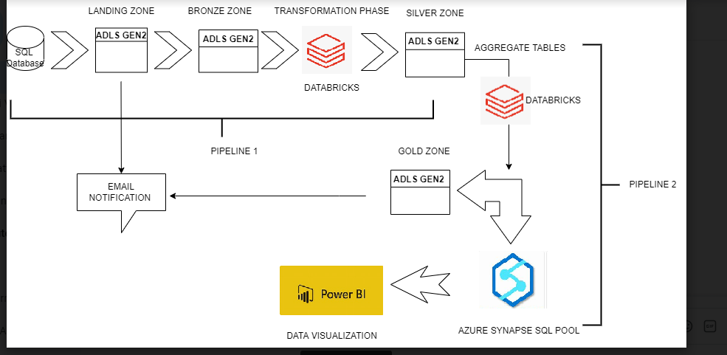
Milestone 1: Goal: Understand the business requirement and create a high-level architecture on Azure

Slide 3
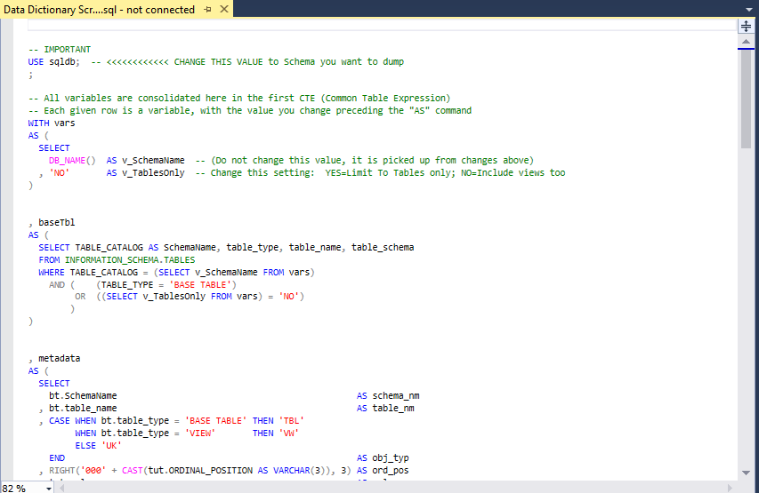
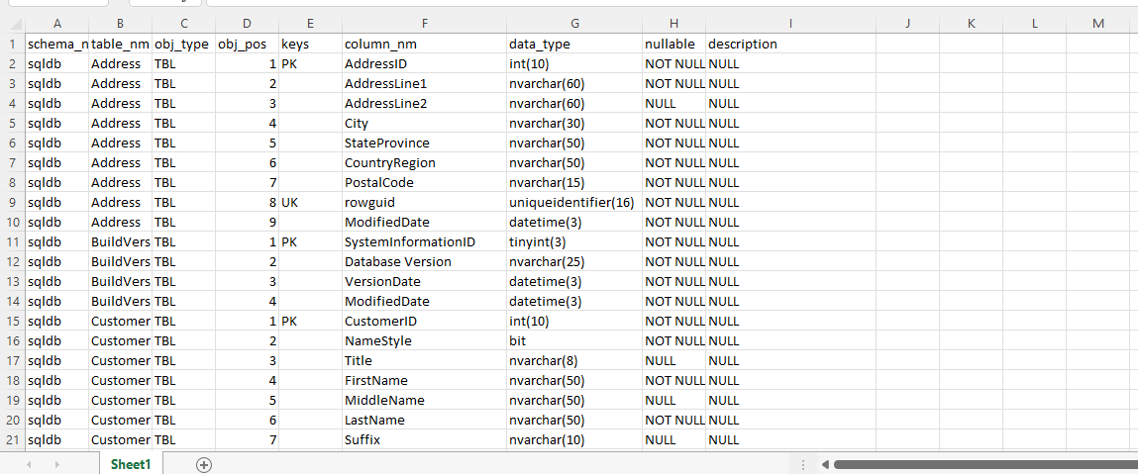
Milestone 2: Goal: Set up source database & create data dictionary

Slide 4
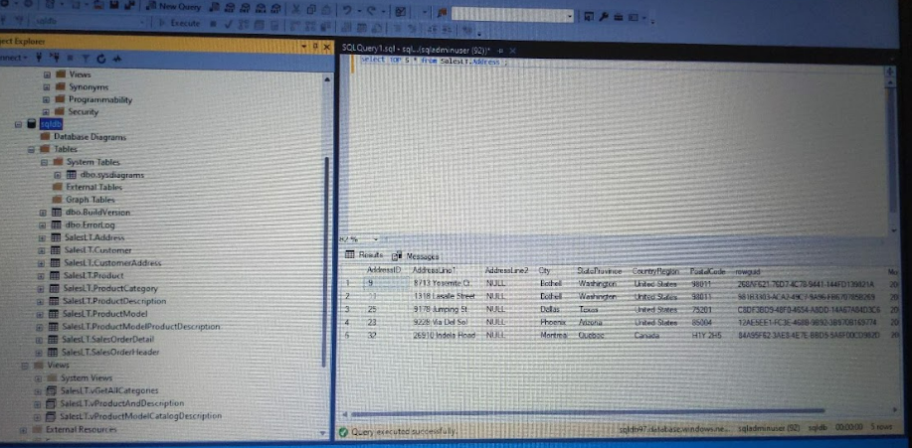
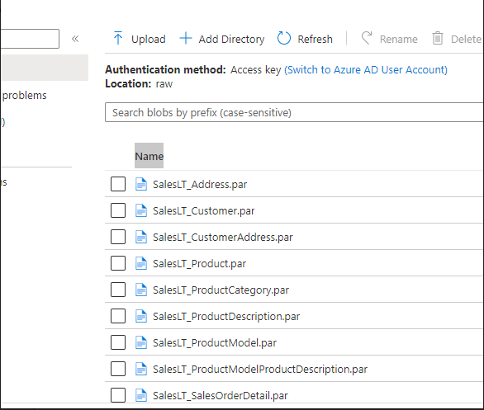
Milestone 3: Goal: Use ADF to copy data from Azure SQL to Landing Zone to bronze zone

Slide 5
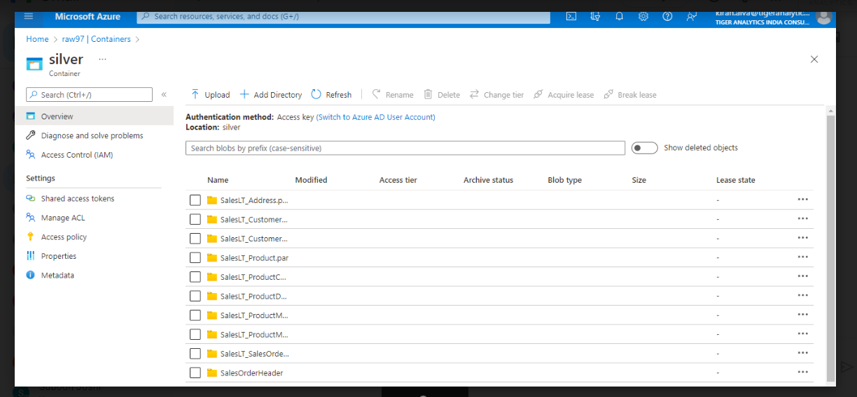
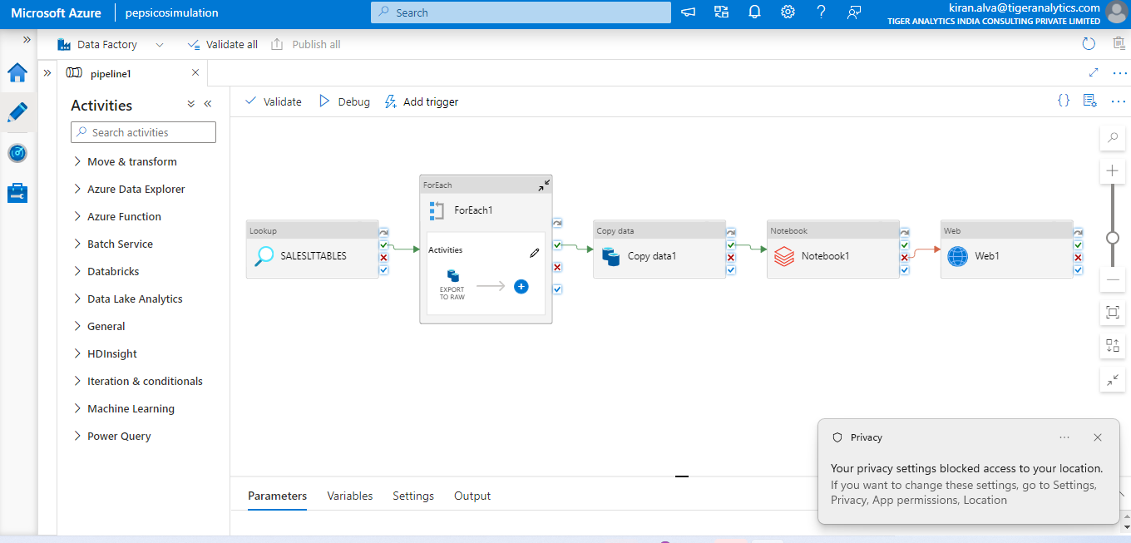
Milestone 4: Goal: Extend the above ADF pipeline to copy data from bronze to silver zone after transformation using Databricks

Slide 6
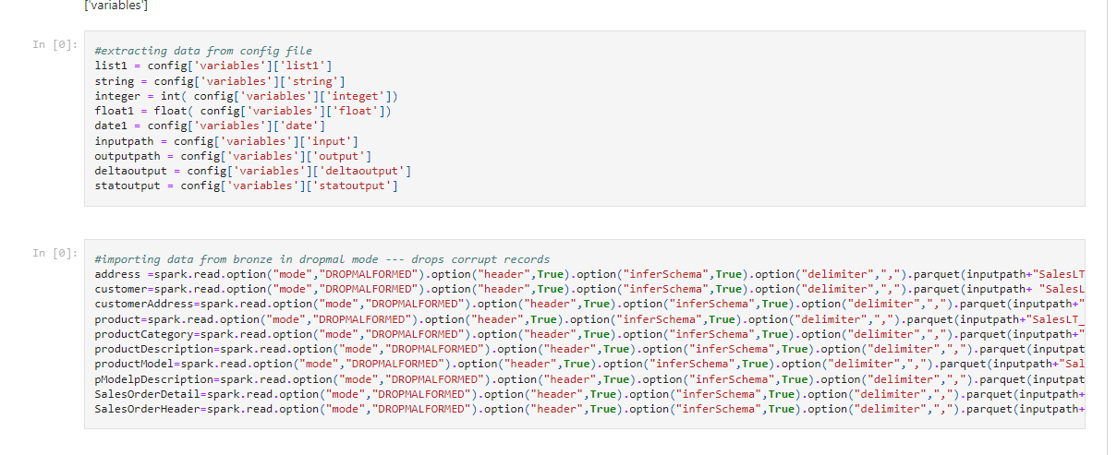
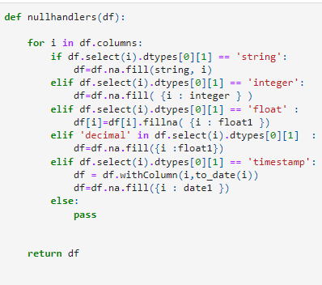
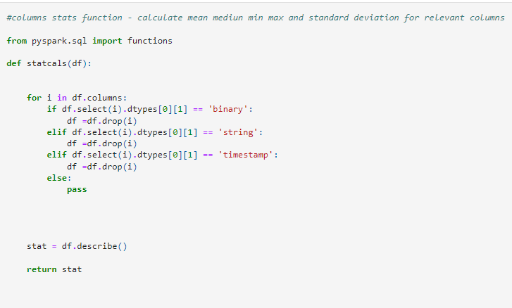
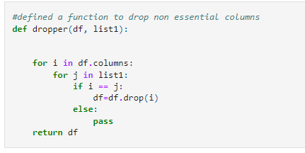
Data Cleaning and Transformation in DataBricks Platform → then loading the data onto Silver Zone

Slide 7
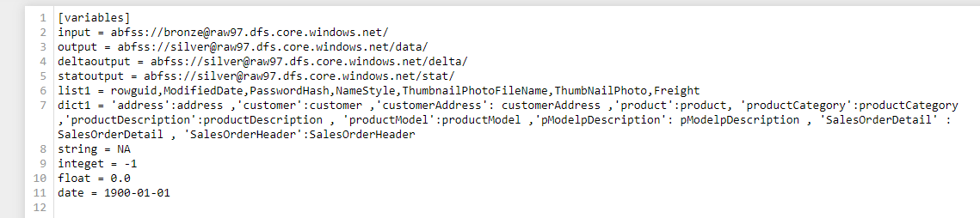
Milestone 5: Goal: Make the pipeline configuration driven

Slide 8
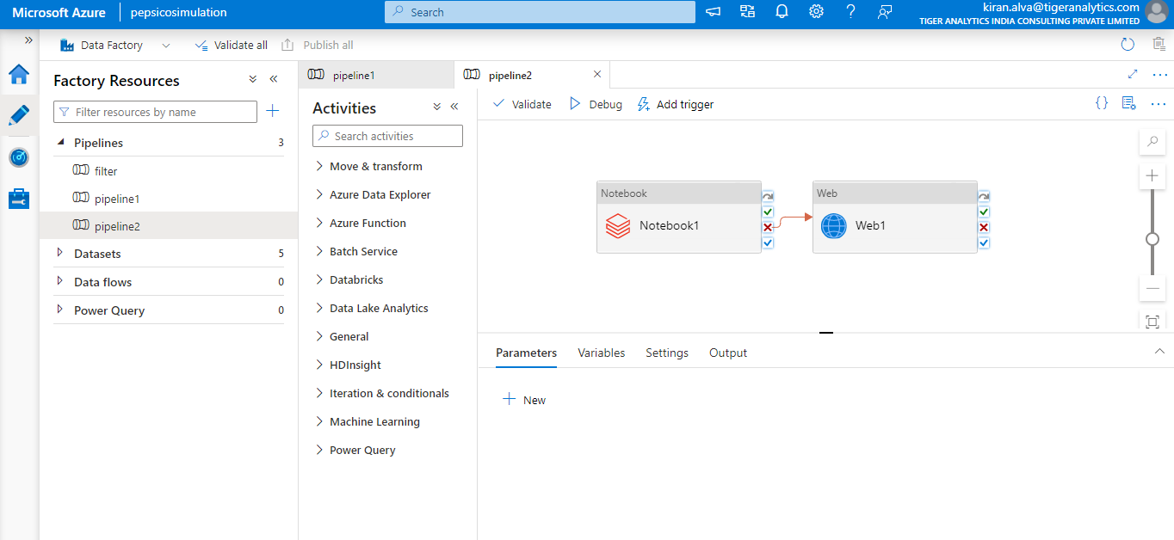
Milestone 6: Goal: Create another ADF pipeline to copy data from silver zone to gold zone after it goes transformation.

Slide 9
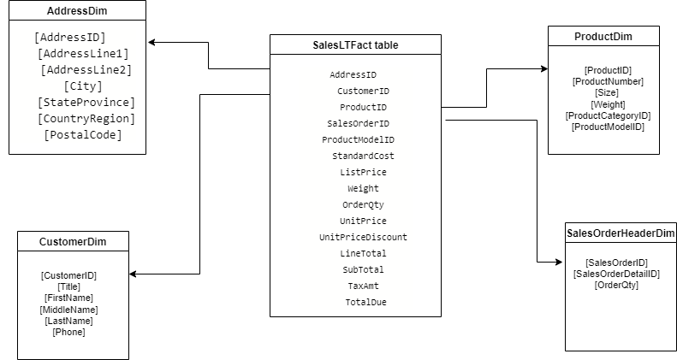
Milestone 7: Goal: Design and Implement a Star Schema → load tables to Synapse SQL Pool and Gold Zone

Slide 10
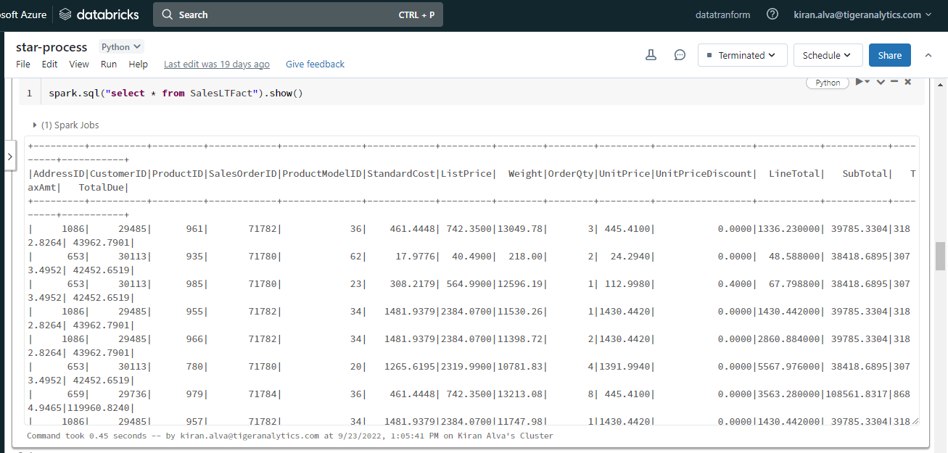
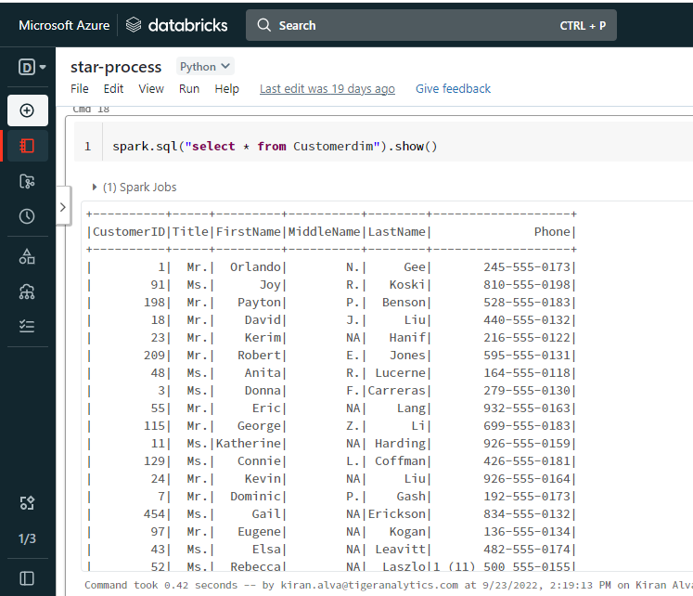
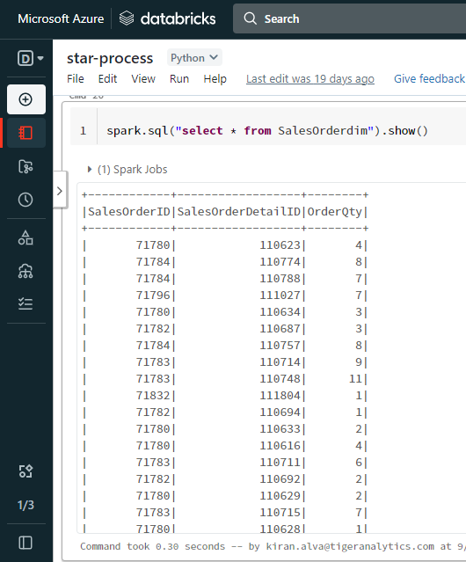
STAR SCHEMA IMPLEMENTATION

Slide 11
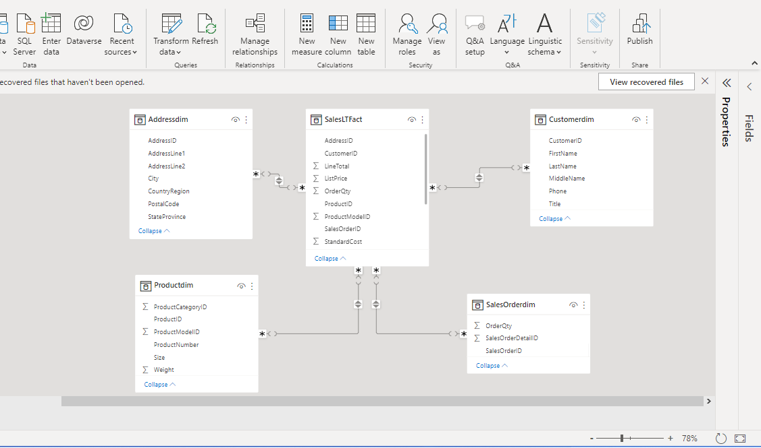
Loading tables from Synaspe SQL Pool to Power BI Star Schema Representation In Power BI Platform

Slide 12
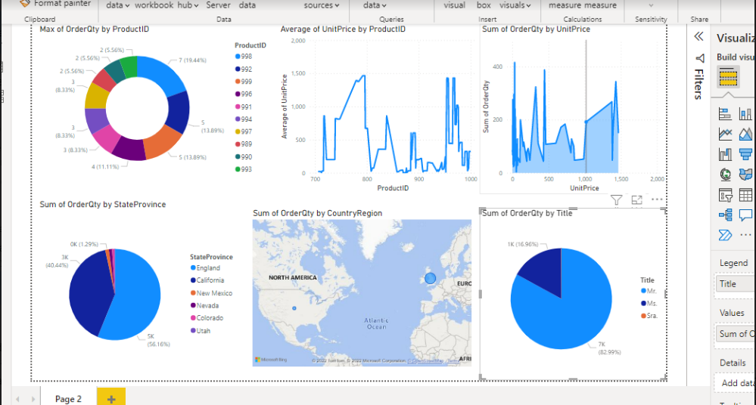
Milestone 7: Goal: Integration with Power BI

Slide 13
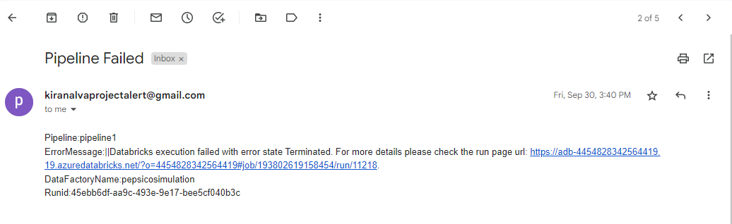
Milestone 8: Goal: Send Email notification alert

Slide 14
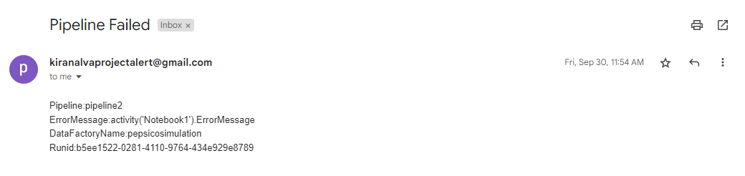
Milestone 8: Goal: Send Email notification alert

